Slide 1
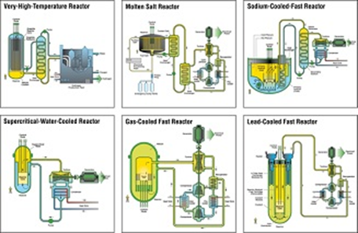
Insert the Title of your paper here The font size will adjust according to the length of the title, Times new Roman. Please keep the size of the blue box intact.
GIF Symposium – Paris (France) – 16-17 October 2018
Name Surname¹, Name Surname¹ and Name Surname²
¹Complete Affiliation of the co-author
²Complete Affiliation of the co-author
SUMMARY
The poster should be a visual presentation of your submitted full paper. Posters should meet the following criteria:
Poster Size - slide orientation: portrait + A0 dimensions: height 1189 mm and width 841 mm
Logos - please insert “GIF Symposium – Paris (France) – 16-17 October 2018“ in the upper left. The logo(s) of your institutions can be inserted anywhere on the poster as per your requirement.
Title – use the same title as in the submitted abstract
The rest of the poster can be arranged in the manner that the author deems appropriate in presenting the information. Please feel free to use this template as well.
III. Section 3 Heading
Xxxxxxxxxxxxxxxxxxxxxxxxxxx
Section 1 Heading
Xxxxxxxxxxxxxxx
II. Section 2 Heading
Xxxxxxxxxxx.
IV. Section 4 Heading
Xxxxxxxxxxxxxxxx
Xxxxxxxxxxxxxxxx
GIF Systems
V. Conclusions
Xxxxxxxxxxxxxxxxxxx
Xxxxxxxxxxxxxxxxxxxxxxxxxxxxxxxxxx

